Slide 1
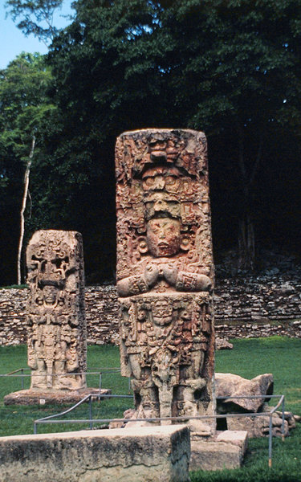
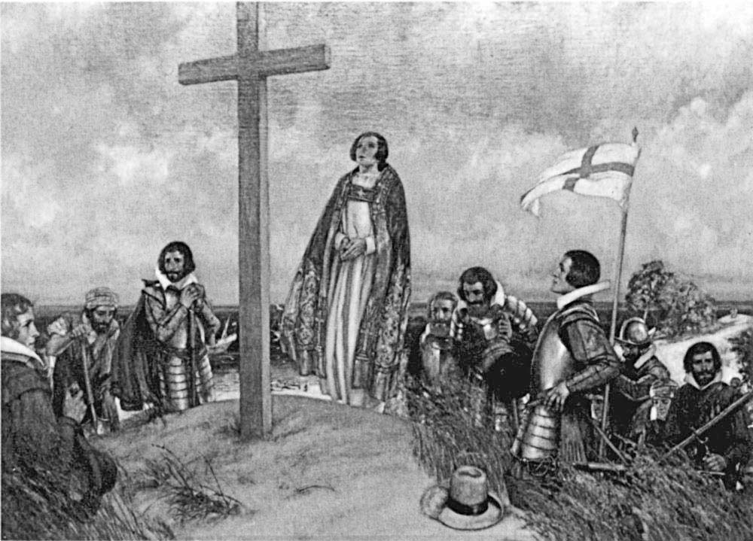
1. New World Encounters
What it was like before the English dominate.
Notes:
Information from Chapter 1 in the text.

Slide 2
Early Civilizations
Arrived across the Bering Straight and migrated South through Central and South America.
Some moved in an eastern direction and created the Mississippian tribes.
Iroquois and others moved further and settled in the Northeast section of US.

Slide 3
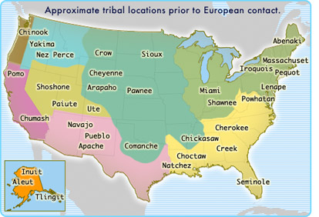

Slide 4

Culture
Groups were diverse
Little interaction between tribes
Little mobility (no horses)
Were unaware of the rest of the world

Slide 5
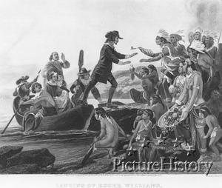
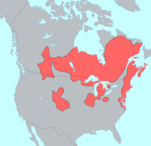


First to Interact with Europeans
Algonquin
  Mohegan
  Pequot
  Narragansett
  Lenape

Slide 6
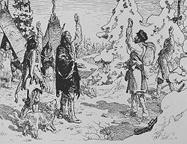
Europeans Arrive
Everything changes

Slide 7
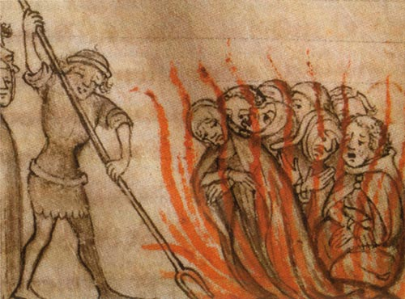
Reason for Interest in New World
Economic depression in Europe
  Overcrowding
  Plagues
Desire to acquire raw materials
  Europe was literally out of wood
  Obtain wealth
Religious tensions
  Reformation and growth of Protestant churches
  Lose of power by Catholic Church
  Persecution on both sides
Renaissance led to growth of curiosity and exploration

Slide 8
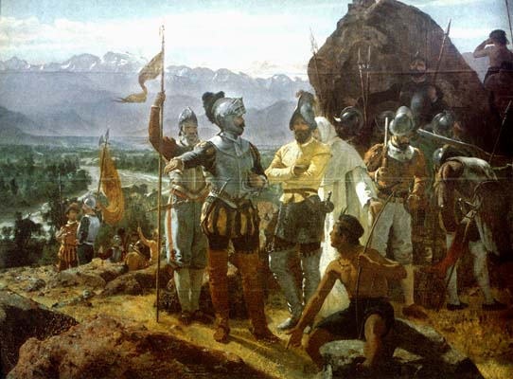
The Spanish
Spanish conquistadors entered much of Central America, South America, the southeastern sections of North America and the area now known as Florida.

Slide 9
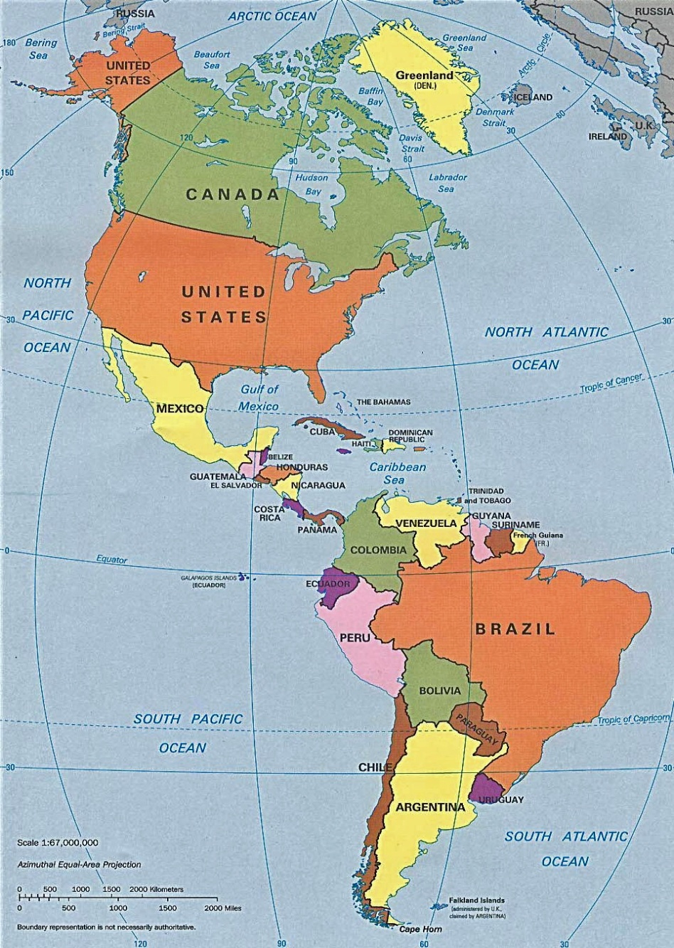

Slide 10
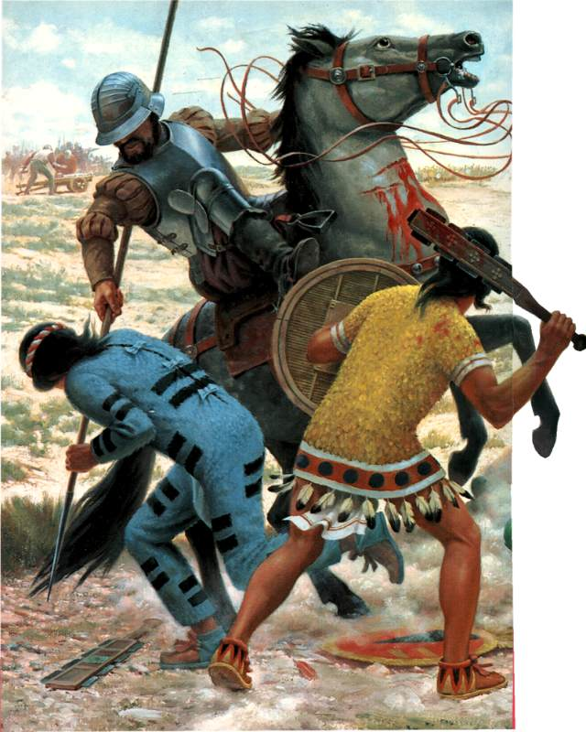
Destroyed Culture
Guns, horses, and diseases brought from Europe all aided the Spanish in their efforts to defeat the native tribes. The Spanish conquered the Aztec, the Incas, and other Native American tribes.

Slide 11
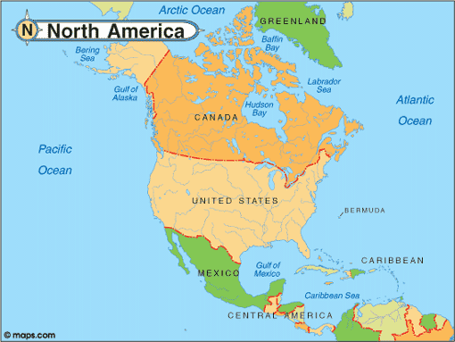
French
French settled in Canada and along the Mississippi River.

Slide 12
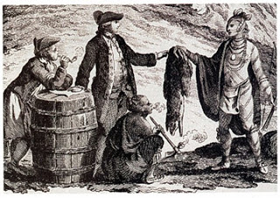
Fewer and Less Brutal
French settlers in Canada were less oppressive than the Spanish. Jesuit priests converted thousands of native Americans to Christianity. French settlers became increasingly interested in fur trading.

Slide 13
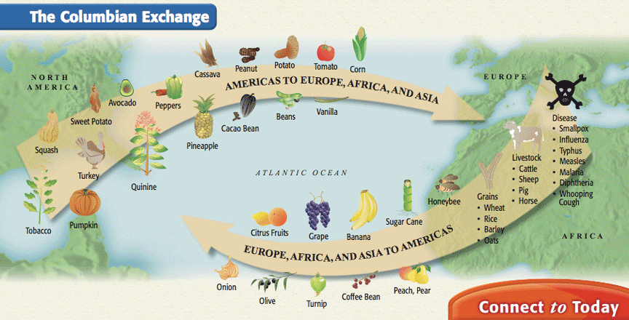
Columbian Exchange

Slide 14
