Slide 1
31. To a New Conservatism
1969 - 1988

Slide 2
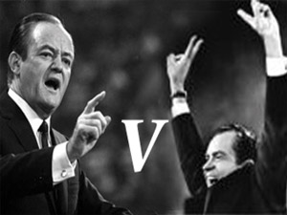
Election of 1968

Slide 3
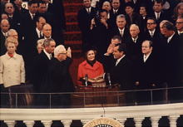
Nixon Pledged Unity
“We cannot learn from one another until we stop shouting at one another – until we speak quietly enough so that our words can be hear as well as our voice.”
Focused on making Johnson’s Great Society more functional.

Slide 4
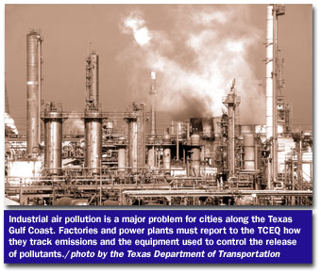
Domestic Policy
Affirmative Action (Civil Rights) – First president to adopt
Environmental Protection Agency (EPA) – was established
Clean Air Act
New Federalism: Shifts more responsibility to the states

Slide 5
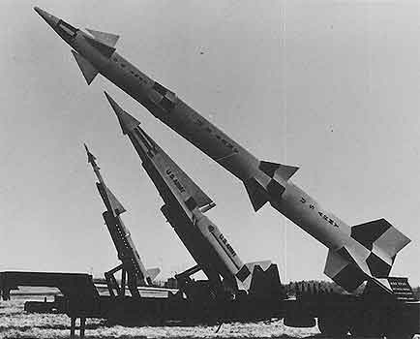
Foreign Policy
Henry Kissinger – National Security Advisor
Wanted to “manage” the Cold War not win it.
“Détente” – Relaxation of tension
Recognition for China
Meant cooperation with the Soviet Union
SALT – Strategic Arms Limitation Talks

Slide 6
Ending the Vietnam War
3 Part Plan
Gradual withdrawal of troops
Train South Vietnamese soldiers (Vietnamization)
Intense Negotiations.
American troops drop from 540,000 to 30,000
Opposition to the war drops
Expanded the war to Cambodia and opposition rises again.

Slide 7
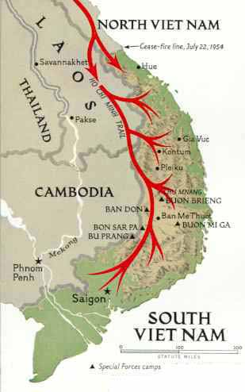

Slide 8
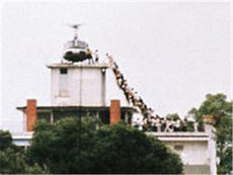
Negotiations Lead to Truce
January 27, 1973
All prisoners of war would be released
US would remove all troops from South Vietnam
South Vietnam would fall to the communists.

Slide 9
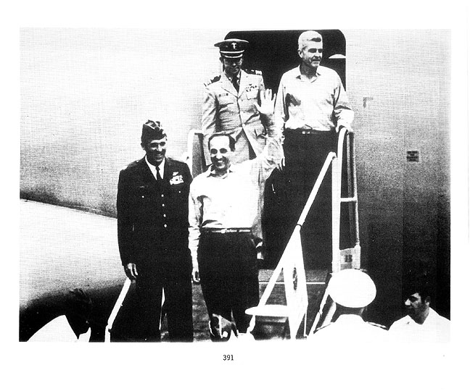
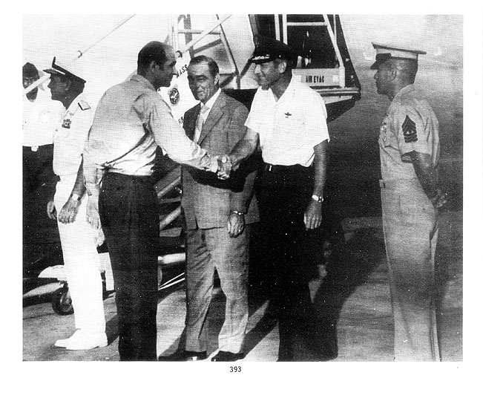
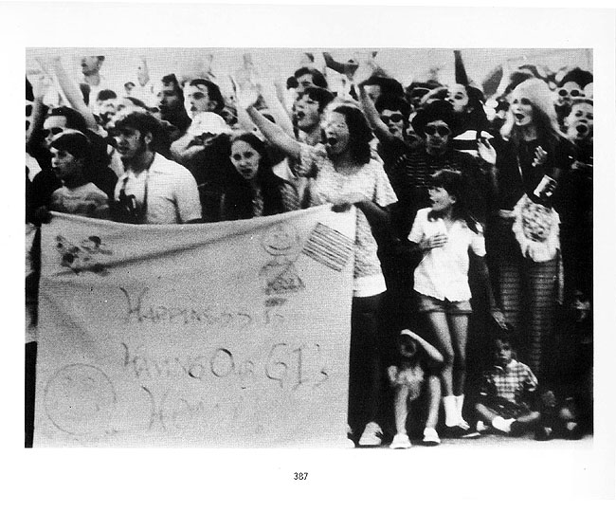
Return of the POWs

Slide 10
The Character of Nixon
Innately shy
Appeared in control
Underneath bitter, hurt, and sensitive to criticism
Remained isolated from Congress, the press, his cabinet and the American people

Slide 11
Watergate Scandal
Group of men hired by Nixon’s reelection committee were caught breaking into the offices of the Democratic national headquarters in the Watergate complex
Part of a number of “dirty tricks” conducted by the Committee to Re-Elect the President (CREEP)
Nixon organized a wide spread cover-up that caused his downfall.

Slide 12
Election of 1972

Slide 13
Economy of Stagflation
War breaks out in Middle East
U.S. and Kissinger negotiated a peace
OPEC (Organization of Petroleum Exporting Countries) cut oil production
Then cut off oil to US in retaliation for US support of Israel
Oil prices quadruple and other prices follow.

Slide 14
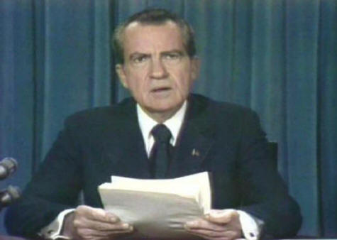
In His Quest for Privacy
Distrusts everyone from the media to members of his won party
Sought to rule the nation without help from anyone.
Sowed the seeds of his own downfall.

Slide 15
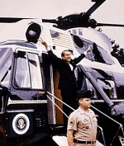
Resignation
House Judiciary Committee voted three articles of impeachment;
Obstruction of justice
Abuse of power
Contempt of Congress
Secret tapes of White House conversations shocked all.
Nixon’s chose to resign on August 9, 1974.

Slide 16
Significance
Some thought the resignation proved that the U.S. constitutional system of checks and balances worked as it was intended.
Others that it underlined the dangerous shift of power to the presidency that began with Franklin Roosevelt
It did contribute to the growing loss of faith in the federal government.

Slide 17
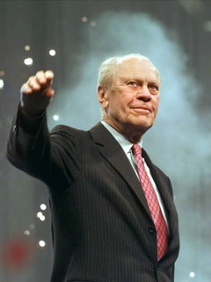
Gerald Ford in the White House
Former congressional representative from Michigan.
Had been picked to replace Spiro Agnew in 1973
Very likeable and unpretentious
Presidential ability questionable

Slide 18
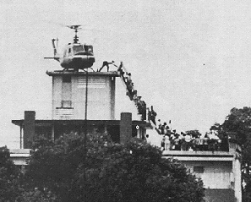
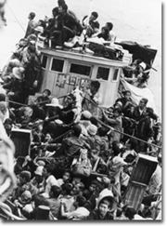
Administration
Grants Nixon a full pardon
Purpose was to end the “national nightmare”
28 other Watergate personalities served jail terms
Investigating the CIA accused of assassination attempts on foreign leaders
Without additional funds, Saigon falls to the communists.

Slide 19
In Asia
Cambodia falls to the Khmer Rouge (Communist)
New government conducted genocide against over a million of its own people
Contrary to Eisenhower’s “domino theory”, the rest of Asia did not fall to communist rule.

Slide 20
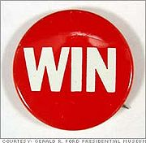
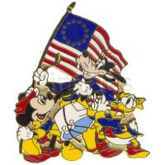
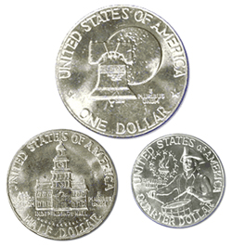
Domestic Issues
Economy continues under stress.
Initiates WIN campaign: “Whip Inflation Now”
Eventually agrees to Democratic stimulus packages
1976 the US celebrates its Bicentennial

Slide 21
New Issues Surface
ERA: Equal Rights for Women
Aggressive environmentalism
Roe v. Wade (1973) abortion rights
Gay Liberation Movement
AIDS Epidemic

Slide 22
Election of 1976

Slide 23
Carter’s Foreign Policy
Human rights diplomacy denouncing oppression of black majority in Africa and actions of military governments in Latin America.
Renegotiated the Panama Canal treaty
Camp David Accords: Peace treaty between Egypt and Israel
Iran Hostage Crisis: Iranian extremists seized the U.S. embassy taking 50 hostages (11/79)
Drug on for the remainder of Carter’s presidency.

Slide 24
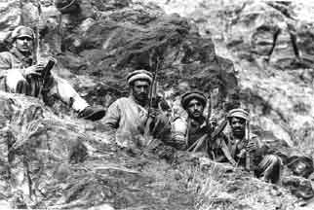
The Cold War
December 1979, Soviets invade Afghanistan.
Fear that Soviet Union was attempting to take over oil producing nations.
Carter’s response
Placed an embargo on grain exports
Boycotting the 1980 Olympics in Moscow
Now had to rebuild military
Détente ends

Slide 25
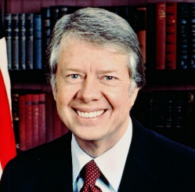
Domestic Policy
Inflation rate continues to grow.
Troubles economy, particularly in the automobile and building trades.
Personal standard of living was on the decline.
By 1980: Approval rating had
Dropped to 23%

Slide 26
Election of 1980

Slide 27
Ronald Reagan
Former governor of California
Former movie actor
Nations was suffering from massive inflation
Blamed it on high government spending and excessive taxes
“Government is the problem.”

Slide 28
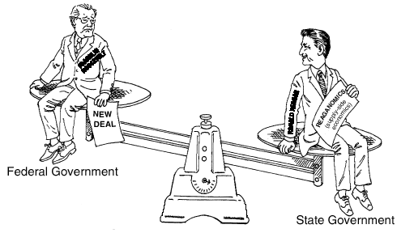
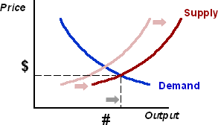
Supply-Side Economics
Tax cuts would encourage private business to invest more
Lead to an economic boom providing new income

Slide 29
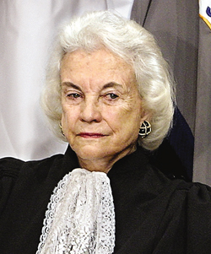
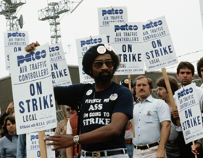
Domestic Agenda
Deregulation encourages free market place to correct the economy
Appoints Sandra Day O’Connor as first woman Supreme Court Justice
Made no strides in civil rights
PATCO Strike

Slide 30
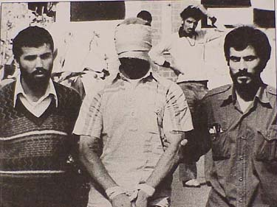
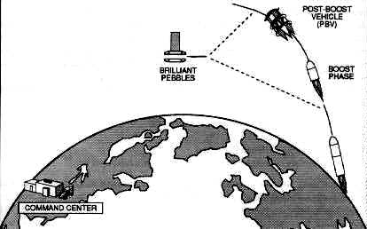
Foreign Policy
Election ends the Iran Hostage Crisis
Challenges the “Evil Empire” (SDI – Strategic Defense Initiative) with antimissile systems

Slide 31
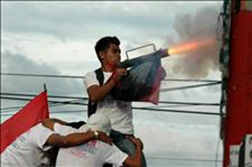
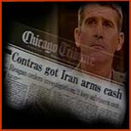
Intervention in Central America and the Middle East
Sandinistas in Nicaragua
Iran-Contra Affair (Arms for hostages)

Slide 32
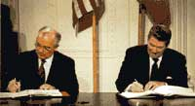
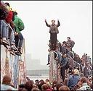
Fall of Communism in Eastern Europe
Intermediate Nuclear Forces Treaty with Mikhail Gorbachev
“Mr. Gorbachev, tear down this wall.”

Slide 33
1. Once in power, how did Nixon respond to LBJ’s Great Society programs?
Did little one way or another
Dismantled almost everything
Worked to expand the programs
Turned them over to the states
Focused on making them function more efficiently.

Slide 34
2. What was the main economic problem which Nixon faced as president?
Inflation
Unemployment
High interest rates
Overproduction
Low retain prices

Slide 35
3. What was détente?
Improving relations with China
Relaxing tensions with the Soviet Union
Increasing tensions with China
Increasing tensions with the Soviet Union
Formalizing diplomatic relations with Vietnam

Slide 36
4. In the Watergate scandal, what was it that finally brought Nixon down?
The testimony of John Dean
The existence of taped conversations
Nixon’s own admission of guilt
The investigation by the Justice Department
Nixon’s firing of the Special Prosecutor

Slide 37
5. What did Gerald Ford do in regards to Richard Nixon?
Resigned as his vice president
Granted him a full pardon
Urged Congress to continue to investigate him
Urged private law firms to prosecute him
Found him a job in the private sector

