Slide 1
1. Assertions and Proofs
A Historical Essay is Much Like a Legal Brief

Slide 2
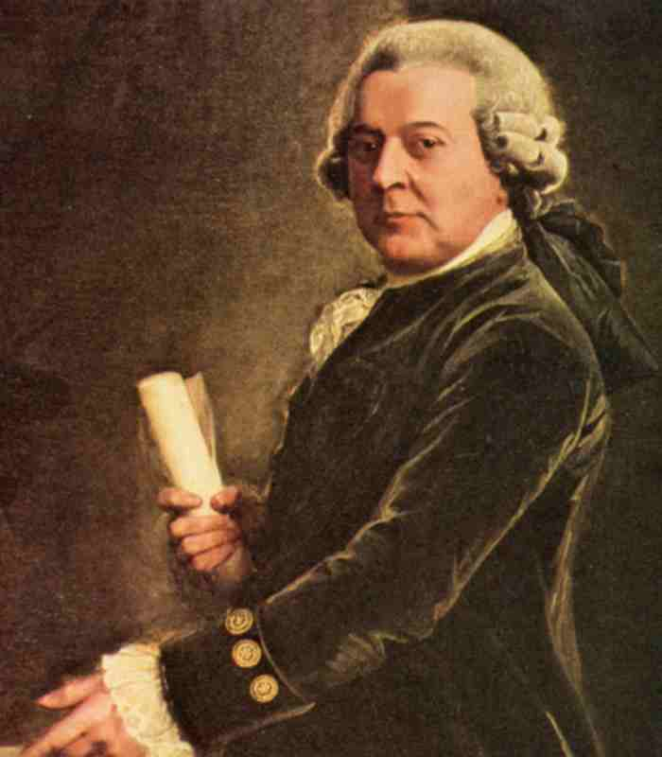
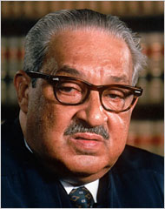
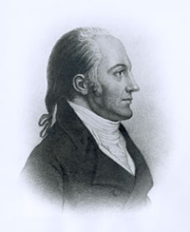
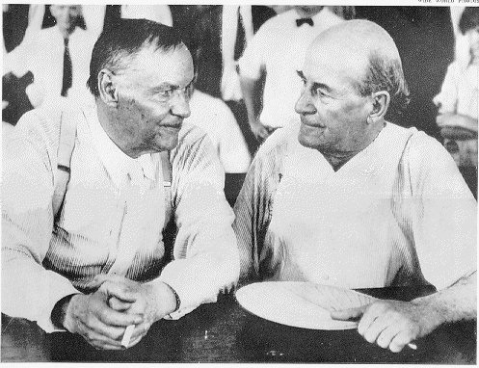
You Want Your Lawyer to:
Be prepared
Argue his case without reservation
Prove to a jury that you are innocent
Use all the evidence that he can find
Be perceived as 100% in favor of his case

Slide 3
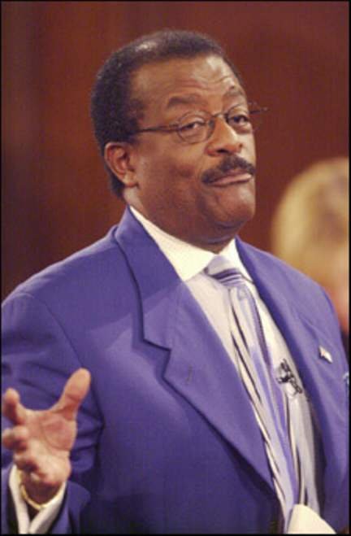
What should Johnny say?
I think the evidence proves that O.J. Simpson is innocent.
In my opinion O.J. Simpson is innocent.
O.J. Simpson might be innocent.
O.J. Simpson is innocent of this crime

Slide 4
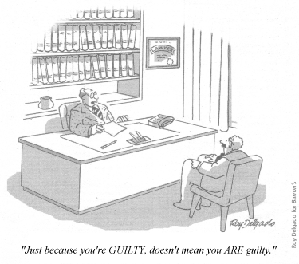
This Positive Statement . .
Is an assertion
You are taking a stand
All thesis statements and historical essays must take a stand
The stand that you take is irrelevant
The proof or evidence is the important element

Slide 5
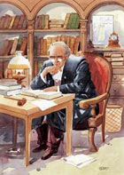
A Good Lawyer Proves His Stand
With evidence
Explanations of the evidence to support his stand
Backed with research
However, “the preponderance of evidence” indicates ….

Slide 6
An Historical Essay
Is more like a debate
Or an argument
Backed with proof of assertion!

Slide 7
Example
Mr. McIver and Ms. Meador are excellent Advanced Placement history teachers. Both of them have received certification through the AP Training Program. They continue to attend training in order to stay current in the methodology of instruction. As a result of their excellent efforts, a number of APUSH students passed the AP test last May. They plan to increase that number in 2012.

Slide 8
Practice
Are you a good student?
Assertion / 3 Proofs (explained)/ End

Slide 9
Writing a Short Response Choose one of the following and respond
Taxes should be raised on individuals in order for the country to get out of debt.
British Petroleum should or should not be punished as a result of the Gulf Oil Spill in 2010
Hurricane Katrina did or did not affect the rest of the United States.

