Slide 1
10. Triumph of White Men’s Democracy
The Administrations of John Q. Adams
Andrew Jackson
Martin Van Buren

Slide 2
State of the Union
A new production system developed in textile mills such as those that existed in Lowell, moves across the country.
The Monroe Doctrine of James Monroe proclaimed that the Western Hemisphere was off-limits to European intrusion.
Missouri Compromise had temporarily halted an explosion over slavery.
The Second Great Awakening was about to lead to the birth of various reform groups.

Slide 3
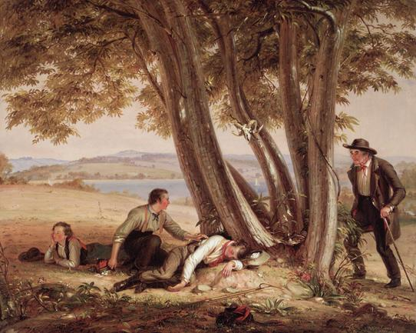
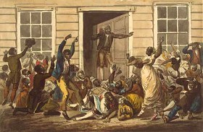
The New Democracy
Rise of “popular sovereignty”
Period of growth in political and social equality
William Sydney Mount (American, 1807–1868). Caught Napping (Boys Caught Napping in a Field), 1848. .
John Lewis Krimmel, Black People's Prayer Meeting, watercolor, ca. 1811, depicting a Methodist service in Philadelphia

Slide 4

Democratic Culture in Literature
Romanticism of the period
  Nathaniel Hawthorne (The Scarlet Letter)
  Herman Melville (Moby Dick)
The Brahmin Poets
  Henry Wadsworth Longfellow
  James Russell Lowell
  Oliver Wendell Holmes
Spirit of Self-Reliance (Ralph Waldo Emerson)

Slide 5
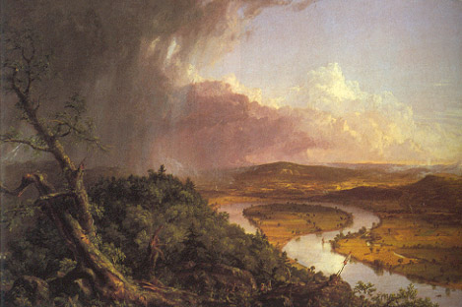
Democracy in the Visual Arts
Thomas Cole
Hudson River School

Slide 6
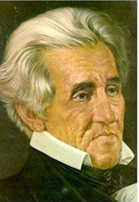
Hero of the Age….
Self-Made Man
A man who begins in poverty but becomes wealthy and powerful as a result of his own endeavors.
Andrew Jackson was a perfect example
a. | 1.
Notes:
Andrew was the poster boy for the self-made man.
Always white, never a woman

Slide 7
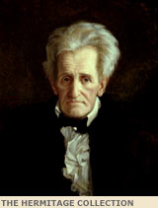
Jacksonian Democracy
Age of the Common Man
Rise of a democratic society
Universal white male suffrage
Permanent two party system
Popular vote for president
Birth of the spoils system
Growth of state level political
activity

Slide 8

Economic Issues
Moving to a market economy created new challenges
Boom and Bust business cycle
Panic of 1819
Growth of state level political activity

Slide 9

Election of 1824
Four candidates from the same party (Jackson, Adams, Clay, Crawford)
Jackson wins popular vote
House of Representatives chooses a president.
Clay throws support to J.Q. Adams
Jackson never forgot
Notes:
Jackson is convinced that he lost the presidency due to a “corrupt bargain.” He is never able to forgive Clay

Slide 10
1824 -1828 John Quincy Adams Administration
Internal improvements
Aid to manufacturing
National university
Astronomical observatory
Like his father, only served
one term.
Notes:
Jackson viewed all of the issues as a waste of money and of time. With the Tariff of Abominations the entire south erupts in dissatisfaction

Slide 11

Revolution of 1828
Jackson runs against Adams in 1828.
Base with southern and western voters
Campaign is not “pretty”.
Worst in national history
Mudslinging involves wives
Notes:
Feelings are running very high against the new tariffs. Jackson’s party resorts to perhaps the worst “mudslinging” in U.S. history.

Slide 12

Birth of the Democratic Party
Supporters of Andrew Jackson
  Vice President John C. Calhoun (now a spokesman for states’ rights)
  Senator Martin Van Buren (supported by a New York political machine)
  Several newspaper editors
Organized to oppose the “American System” of Henry Clay

Slide 13
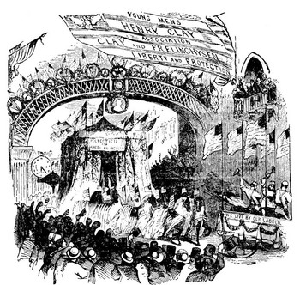
Whig Party
Formed in opposition to Jackson’s stand on the Bank of the United States.
Name came from American and English association with opposition to royal power.

Slide 14
Democrats and Whigs in the Age of Jackson
Democrats
Supported local rule, limited government, free trade, equal economic opportunity
Opposed monopolies, national bank, high tariffs, high land prices.
Base: Southerners, westerners, small farmers, urban workers
Whigs
Supported Clay’s American System (National bank, Internal improvements, protective tariff
Opposed immorality, vice, crime blamed on immigrants.
Base: New Englanders, mid-Atlantic, upper- mid west, Middle class urban professionals
Notes:
Chart explains the differences between the two parties. Do you see any similarities in today’s major parties.

Slide 15
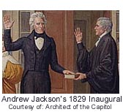
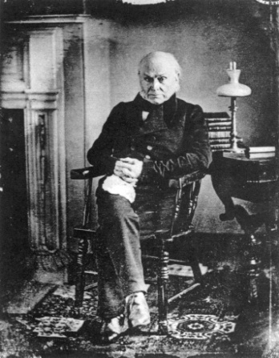
Two Attitudes
The “money power” endangered the survival of republicanism
“Rabble rousers” such as Andrew Jackson would manipulate the electorate in order to pass outlandish legislation.
Jacksonian Democrats
Federalist Conservatives

Slide 16
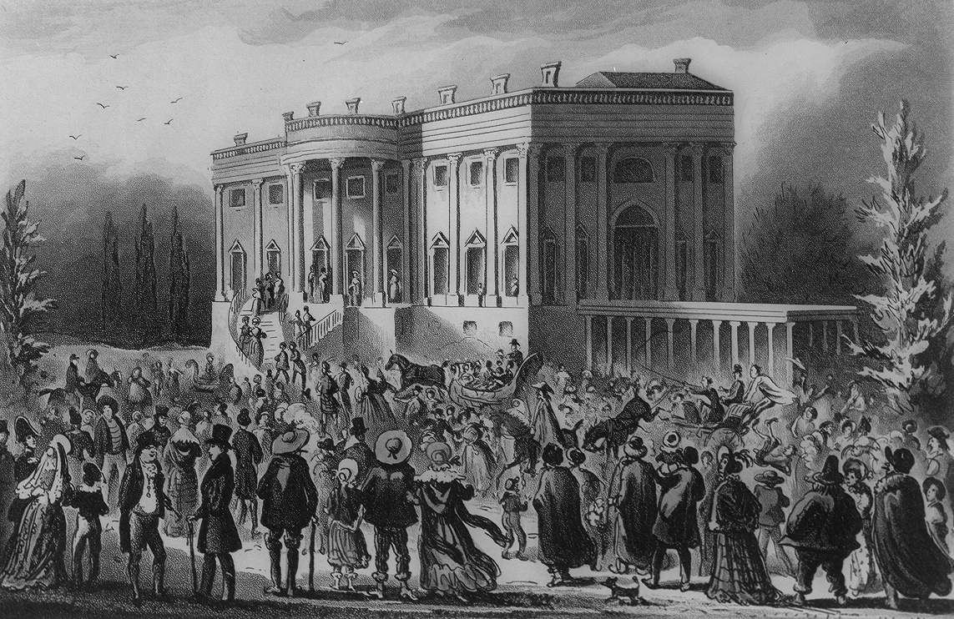
Jackson wins!

Slide 17
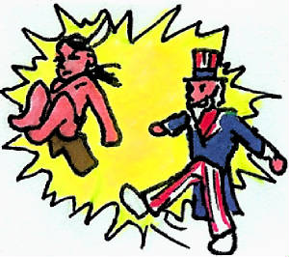
New President
Unclear on
  Internal improvements
  Banks
  Tariffs
Very clear on the removal of Indians from Gulf Coast States

Slide 18
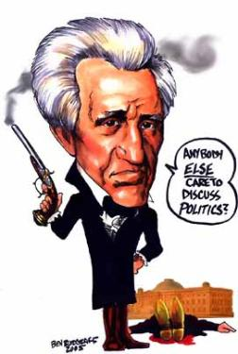
Old Hickory
One of the most powerful of all presidents
Strong willed
Intolerant of opposition
Never forgave an perceived injustice
Often violent

Slide 19
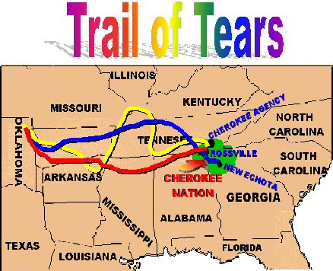
First Major Decision:
Indian Removal Act (1830)
Sympathized with citizens who want Indian land.
Ignored Supreme Court decision in favor of Indians (Worcester v. Georgia)
Wanted to settle all west of Mississippi
By 1835 most had moved
Bureau of Indian Affairs set up
Trail of Tears
Notes:
Jackson was assertive in his action against the Native Americans. He openly defied the Marshall Court and ordered the removal of Cherokees for the Southeast to the Oklahoma Territory.

Slide 20
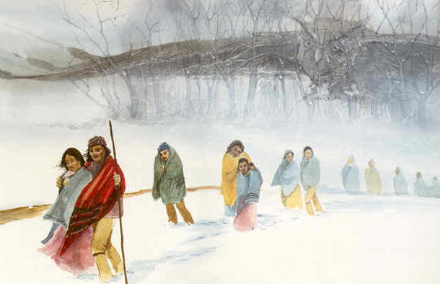
Notes:
The Trail of Tears becomes the topic of a great many stories and art pieces

Slide 21
“The Tariff of Abominations.”
1828
Attempt at compromise that resulted in an extremely high tariff
No one was happy
Particularly the South
Early example of the effect of special interest groups.

Slide 22
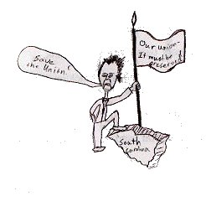
Nullification Crisis
Tariff of Abominations, 1828
South Carolina nullifies
Threatens secession
Andrew Jackson vs. John C. Calhoun
(Same as Virginia and Kentucky Resolutions under John Adams.
Notes:
South Carolina leads the southern states in their opposition to the Tariffs of 1828. John C. Calhoun is the leading spokesman and he declares that it is within the legal rights of the state to nullify an inappropriate law. Jackson disagrees. Even, though he is a southerner, he stands firm in the belief the the federal government is supreme. As the debate goes on, the tariff is modified and lowered and the issue goes away again.

Slide 23
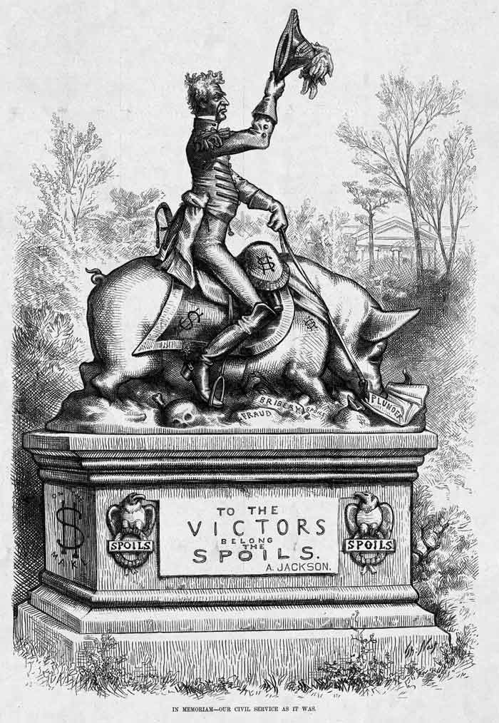
Defends the Spoils System
Half way through his first term, he reorganizes his cabinet
Feud with Vice-President John C. Calhoun and the nation’s first sex scandal.

Slide 24
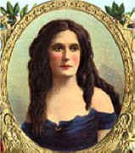
Peggy Eaton Affair
D.C.’s first sex scandal
Peggy Eaton snubbed by other cabinet wives
Jackson forces acceptance
Most resign.
Notes:
Jackson does not waste time in replacing all the individuals. Martin Van Buren of New York was chosen to be the new vice president because he remained loyal to Jackson through this crisis.

Slide 25

Maysville Road
National road in Kentucky
Andrew Jackson vs. Henry Clay
Jackson vetoes and shows support for southern mistrust of internal improvements.
Notes:
This is the same issue as has been addressed before. Is it constitutional for the national government to fund internal improvements that are within only one state. The fact that Jackson’s political enemy (Election of 1824) is involved might have sweetened the fight.

Slide 26
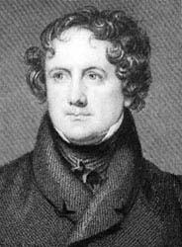
Bank Wars
Second Bank of the United
Andrew Jackson vs. Nicholas Biddle and Henry Clay
Saw bank as control of the rich and powerful
Notes:
Biddle was the director of the Bank of the United States. He was actually a very competent manager. Yet, his image was one of great wealth and privilege. The very things that Jackson and his supporters were opposed to. The second bank was scheduled to be rechartered after Jackson’s term was over. However, Biddle foolishly applied for a recharter early and the war was on.

Slide 27
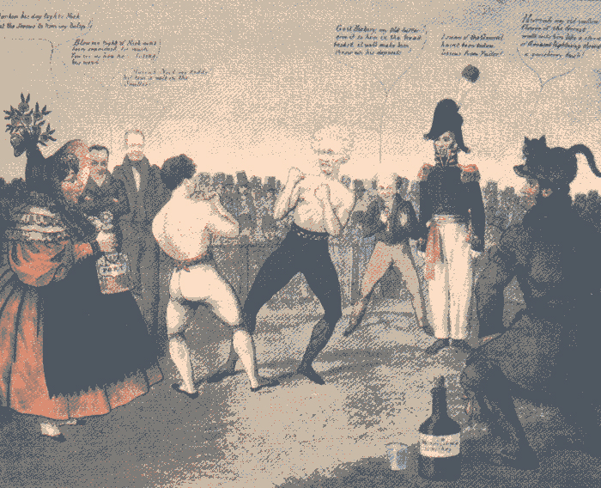
Notes:
In this Bank War cartoon, Jackson boxes Biddle as Webster and Clay urge Biddle on and Van Buren shouts instructions from Old Hickory's corner. The heavy-set woman holding a bottle of port (an upper class beverage) represents the national bank, bloated with privilege and wealth, while a plain American in frontier garb keeps watch over Jackson's bottle of whiskey, the drink of the masses.

Slide 28

Death of the Bank of US
Jackson pulls all federal funds out of the Bank of the United States (BUS)
Deposits money in state “pet banks”.

Slide 29

Jackson’s Second Term
Deals with fall out of death of Bank and Pet Banks.
Prices become inflated
Issues Specie Circular
  Only gold and silver could be used to purchase public land
  Led to the Panic of 1837
Notes:
Jackson pulls all the federal funds out of the Bank of the US after he vetoes the bill. Deposits those funds in “pet” state banks. Rapid inflation results with land prices skyrocketing. The currency is no longer solid
Deals with this issue by issuing the presidential order called “Specie Circular”. This states that federal land can only be purchased with god or silver….no paper money
Ends in the Panic of 1837

Slide 30
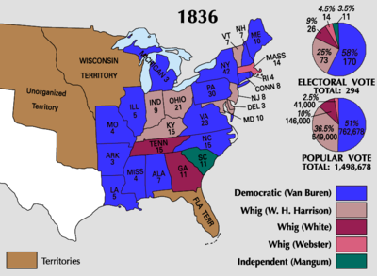

Slide 31
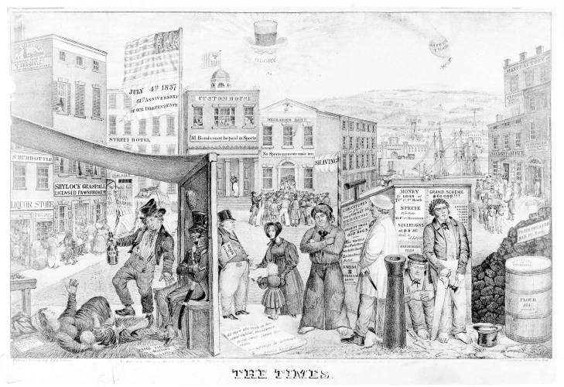
Panic of 1837
Price of cotton cut in half
Banks failed
Many businesses went bankrupt
Large number of unemployed
Notes:
A commentary on the depressed state of the American economy, particularly in New York, during the financial panic of 1837. Again, the blame is laid on the treasury policies of Andrew Jackson, whose hat, spectacles, and clay pipe with the word "Glory" appear in the sky overhead. Clay illustrates some of the effects of the depression in a fanciful street scene, with emphasis on the plight of the working class. A panorama of offices, rooming houses, and shops reflects the hard times. The Customs House, carrying a sign "All Bonds must be paid in Specie," is idle. In contrast, the Mechanics Bank next door, which displays a sign "No specie payments made here," is mobbed by frantic customers. Principal figures are (from left to right): a mother with infant (sprawled on a straw mat), an intoxicated Bowery tough, a militiaman (seated, smoking), a banker or landlord encountering a begging widow with child, a barefoot sailor, a driver or husbandman, a Scotch mason (seated on the ground), and a carpenter. These are in contrast to the prosperous attorney "Peter Pillage," who is collected by an elegant carriage at the far right. In the background are a river, Bridewell debtors prison, and an almshouse. A punctured balloon marked "Safety Fund" falls from the sky.

Slide 32

Led to Fall of Van Buren
International in scope
Whigs choose to blame Jacksonian policies on the economic downfall
Whigs offered a conservative solution in the form of a new version of Clay’s American System.

