Slide 1
29. Affluence and Anxiety
1946 - 1960

Slide 2
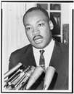
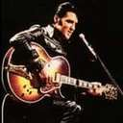
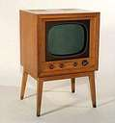

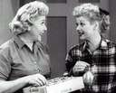

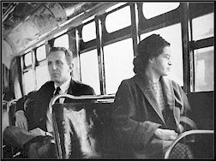

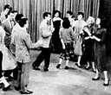





Slide 3

Prosperity
Between 1945 and 1960, the per-capita disposable income of Americans tripled
Americans had the highest standard of living in the world.

Slide 4
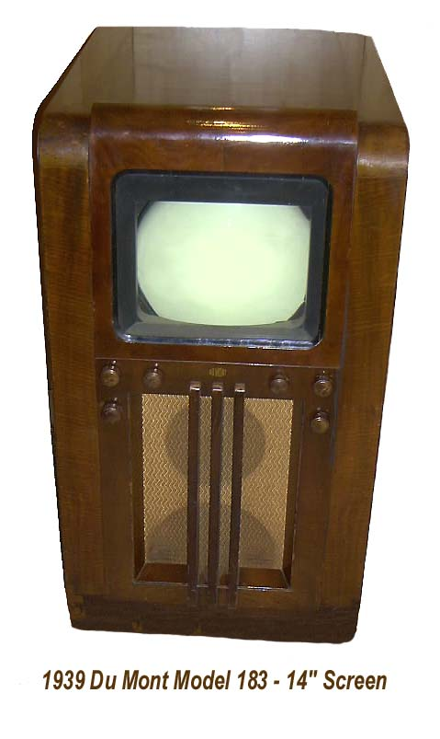
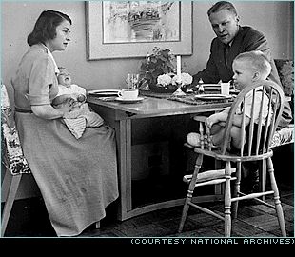
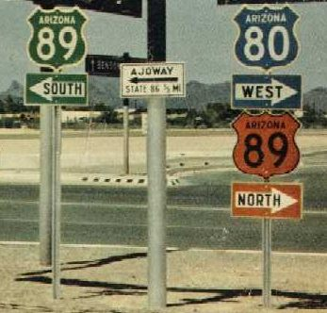
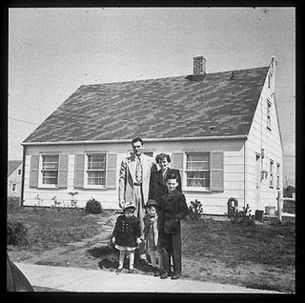
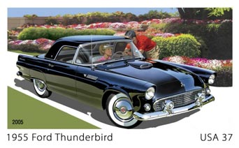
By 1950
US enjoyed the highest standard
living achieved by any society in history
Savings had grown during war
Consumers were ready to spend

Slide 5
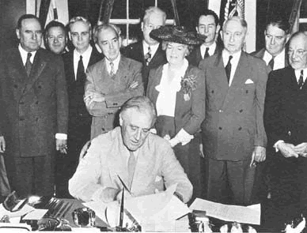
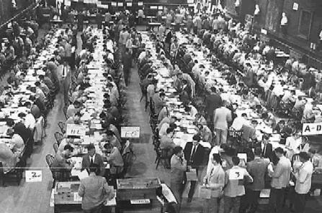

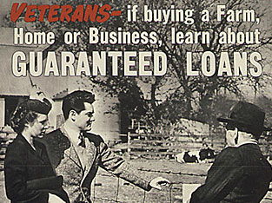
G.I. Bill
Servicemen’s Readjustment Act of 1944
Helped returning veterans adjust back home
  Provided education (boom in higher education)
  Low interest loans (homes, farms, business)

Slide 6
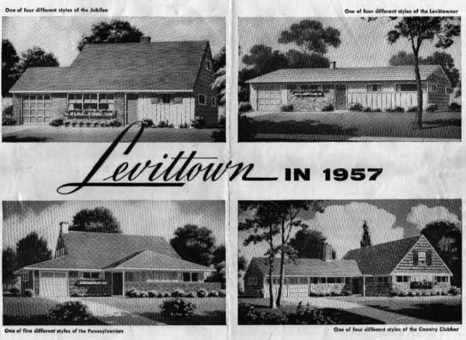
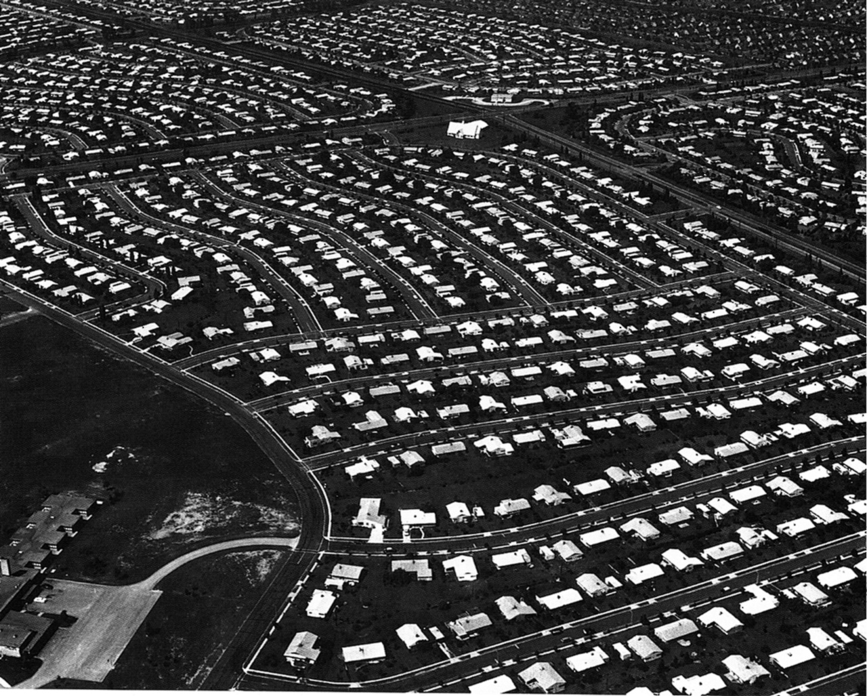
Suburban Growth
Construction Boom
Levittown: 17,000 mass-produced low priced family homes in Long Island, New York
William J. Levitt

Slide 7

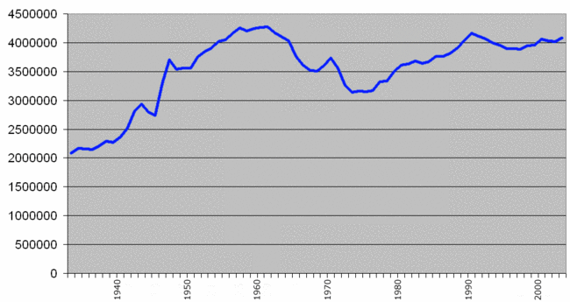


Baby Boom
Younger marriages and larger families
50 million babies between 1945 and 1960

Slide 8
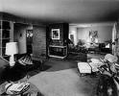

In a Single Generation
Majority of middle-class Americans moved to suburbs
Cities became increasingly poor and racially divided.

Slide 9







Had Become a Consumer Society

Slide 10
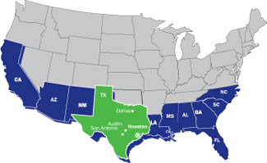

Rise of the Sunbelt
Millions moved from Northeast and Midwest
To South and West (Florida to California)
Shift of industry, people and political power

Slide 11
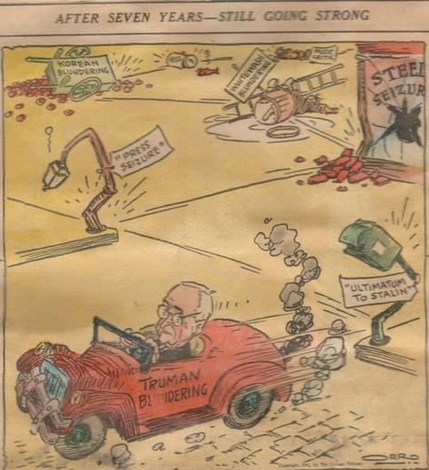
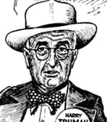

Harry S Truman
Replaced Franklin Delano Roosevelt
Matured into a decisive leader
Basic honesty and unpretentious style appealing

Slide 12

The Fair Deal
Reform program
National health care insurance
Federal aid to education
Civil Rights
Public housing
New farm program
Conservatives blocked most

Slide 13
When President Harry Truman picked up his "Washington Post" early on December 6, 1950, to read a review of his daughter Margaret Truman's singing performance, he was livid. Though conceding that Miss Truman was "extremely attractive," Paul Hume, the "Post's" music critic, stated bluntly that "Miss Truman cannot sing very well" and "has not improved" over the years. The president wrote the following letter to the 34-year old Hume, whom he compared to the columnist Westbrook Pegler ("a rat," in Truman's view).

Slide 14
Mr. Hume:
I've just read your lousy review of Margaret's concert. I've come to the conclusion that you are an "eight ulcer man on four ulcer pay."
It seems to me that you are a frustrated old man who wishes he could have been successful. When you write such poppy-cock as was in the back section of the paper you work for it shows conclusively that you're off the beam and at least four of your ulcers are at work.
Some day I hope to meet you. When that happens you'll need a new nose, a lot of beefsteak for black eyes, and perhaps a supporter below!
Pegler, a gutter snipe, is a gentleman alongside you. I hope you'll accept that statement as a worse insult than a reflection on your ancestry.
H.S.T.

Slide 15

Economic Program
Employment Act of 1946: Council of Economic Advisers to promote economic welfare
Southern Democrats and Republicans unite to relax controls of World War II
Inflation rate rising 25%
4.5 Million workers strike in 1946
Truman took strong approach

Slide 16
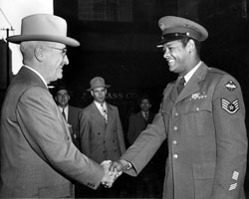
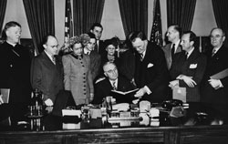
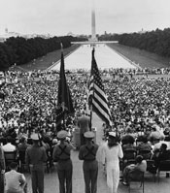
Civil Rights
Used Executive Powers to form Committee on Civil Rights
1948 ended segregation in federal government and armed forces
Southern Democrats blocked most of his civil rights legislation

Slide 17
Taft-Hartley Act (1947)
Outlaws closed shop (contract requires union membership before hiring)
States can pass “right to work” laws (requirement to join after hiring)
Outlaws secondary boycotts (other unions joining)
President has the power to invoke 80-day cooling off period
Passed over Truman’s veto
Major issue dividing Democrats and Republicans for years

Slide 18

Republicans Gain Control
Congress in 1946
Roll back some of the New Deal gains for labor
22nd Amendment (1951): Two term limit

Slide 19
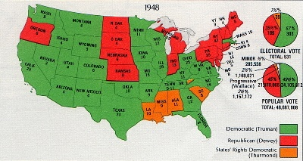
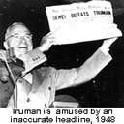
Election of 1948

Slide 20
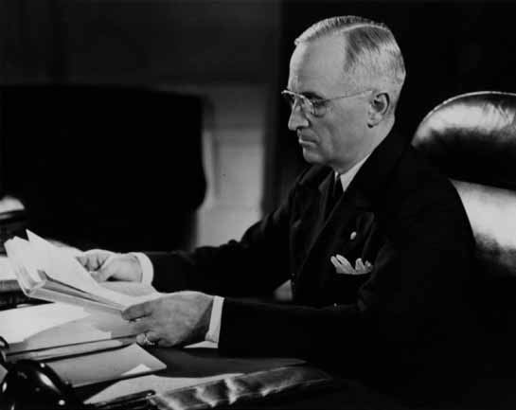
Two Reasons for Defeat
Truman’s conflict with Congress
Pressing foreign policy with Cold War

Slide 21
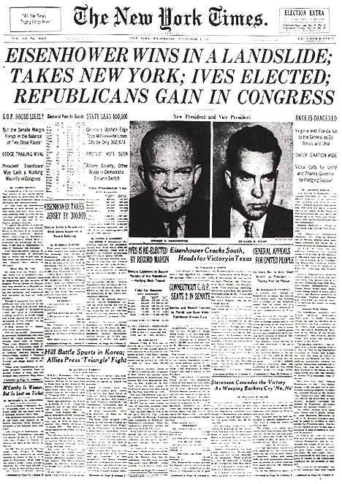

Slide 22
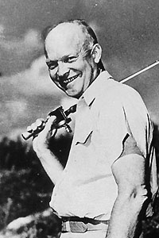
Domestic Policies
Governed by delegation
Cabinet full of former businessmen
Often criticized in the press for golfing and fishing.

Slide 23

Areas of Greatest Growth
Organized religion
More kids in school strains education system
More college students
Television
Consumer culture

Slide 24
Critics of the Consumer Society
Beatniks
David Riesman
C. Wright Mills
Jack Kerouac
All found fault with the blandness, conformity, corporate dehumanization, and loss of individuality of the 1950s.

Slide 25
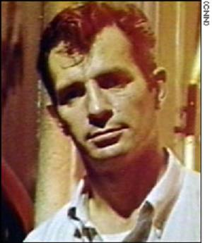
“Great things are not accomplished by those who yield to trends and fads and popular opinion.”
“Houses are full of things that gather dust”

Slide 26
"I realized these were all the snapshots which our children would look at someday with wonder, thinking their parents had lived smooth, well-ordered lives and got up in the morning to walk proudly on the sidewalks of life, never dreaming the raggedy madness and riot of our actual lives, our actual night, the hell of it, the senseless emptiness."
— Jack Kerouac (On the Road)

Slide 27

Response to Sputnik (1957)
Concern that the US was no longer ahead of the Soviet Union in technology.
Creation of NASA
Reorganization of American educational system.

Slide 28
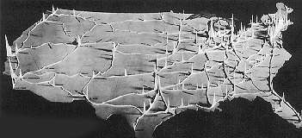
Modern Republicanism
Fiscal conservatism
Encouragement of private enterprise
Reduction of federal programs
Major contribution: Highway Act of 1956.

Slide 29

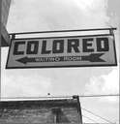
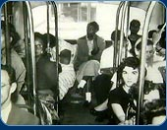
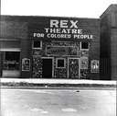

Changing Attitudes
Cold War brought negative attention to these conditions in the U.S.
Racial segregation and discrimination stood out as glaring wrongs that needed to be corrected.

Slide 30
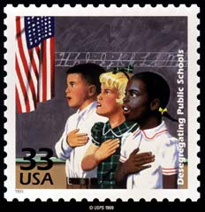
Desegregating Schools
Brown v. Board of Education of Topeka, Kansas

Slide 31
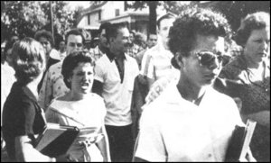
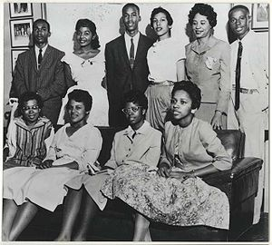
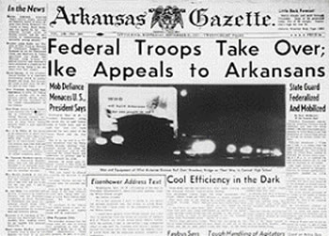
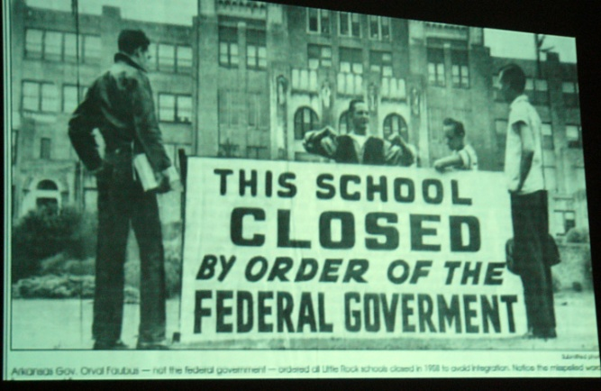
Crisis at Little Rock

Slide 32
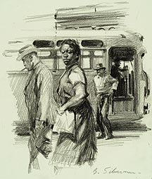
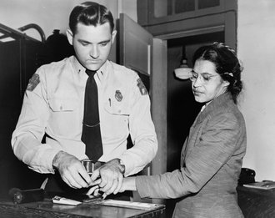
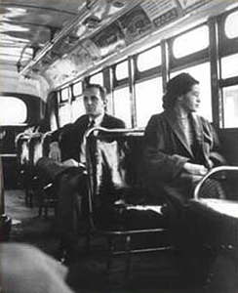
Beginning of Black Activism
Rosa Parks
Martin Luther King, Jr.
Montgomery Bus Boycott

Slide 33
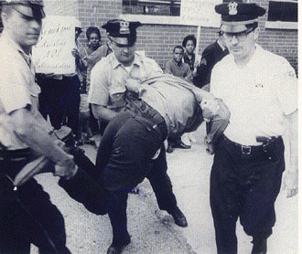
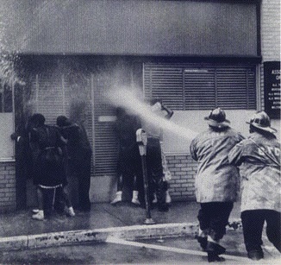
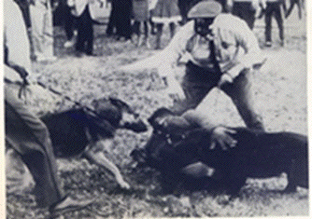
Federal Laws
Civil Rights Laws of 1957 and 1960
First since Reconstruction
Modest in scope
Still many obstructive tactics to voting

Slide 34
1. Which of the following best describes the American economy 1945-1960?
A second Great Depression
Flat, no growth or contraction
Unparalleled economic growth
Slow but steady contraction
Slow but steady growth

Slide 35
2. What was life in the suburbs most dependent on?
Medical care
The automobile
Television
Two working parents
Expensive housing

Slide 36
3. Education in the 1950s
Was regarded as unimportant
Was put under strain by the baby boom
Moved away from traditional academics
Never received Federal funding
Was designed to keep most people out of college.

Slide 37
4. How did the American people react to the launch of Sputnik?
They were unconcerned
They thought it was a hoax
They created NASA and increased education funding
They immediately launched a bigger and better satellite
They launched a man into orbit soon afterward.

Slide 38
5. What was the most important legislative achievement of the Eisenhower years?
Landing a man on the moon
A major tax cut
The Interstate highway Act of 1956
Ending the Korean War
Enactment of Medicare and Medicaid

Slide 39
6. Who emerged as a major black leader at this time?
Martin Luther King
Malcolm X
Huey Newton
Jesse Jackson
Mohammad Ali

