Slide 1
30. The Turbulent Sixties
1960 - 1969

Slide 2
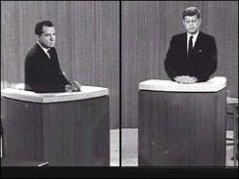
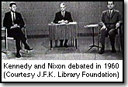

September 26, 1960
Televised Presidential Debate
John F. Kennedy (D) and Richard M. Nixon (R)

Slide 3
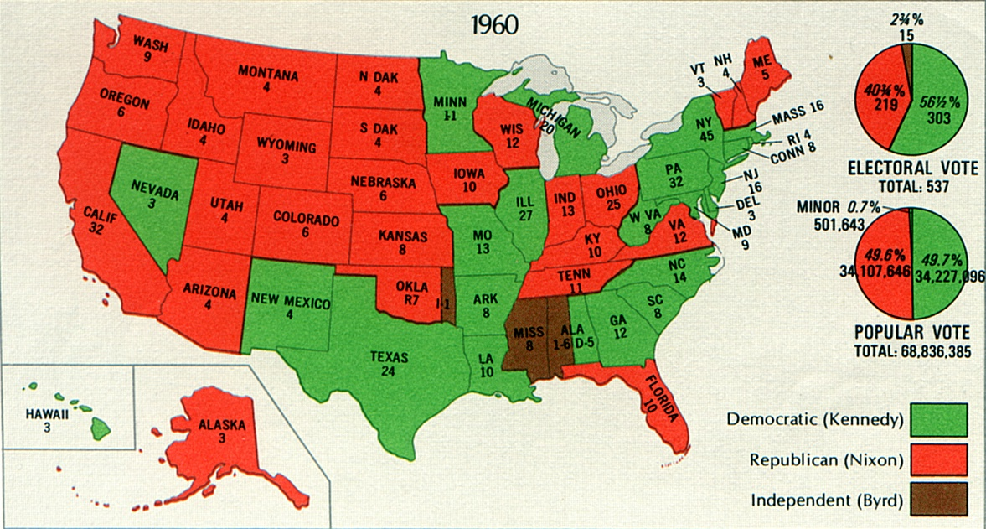
Election of 1960

Slide 4
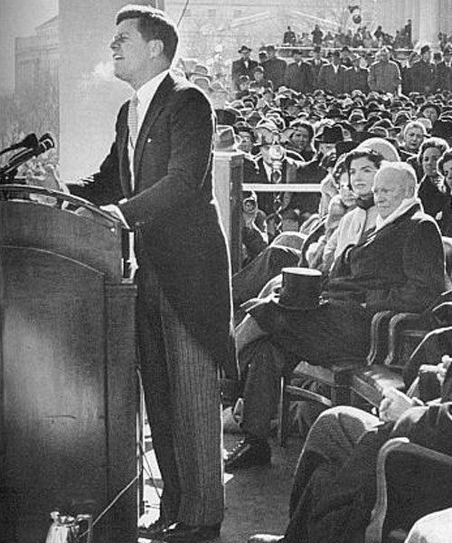
Kennedy’s Inauguration
“Let every nation know, whether it wishes us well or ill, that we shall pay any price, bear any burden, meet any hardship, support any friend, oppose any foe to assure the survival and success of liberty. We will do all this and more.”

Slide 5

Focused on Foreign Affairs
Berlin Crisis
Civil War in Vietnam
Fidel Castro in Cuba
Cabinet
  Dean Rusk, Secretary of State
  Robert McNamara, Secretary of Defense
  Robert F. Kennedy, Attorney General

Slide 6

Flexible Response
Build up military
  Green Berets
  $6 billion increase for defense
Particularly the missile program

Slide 7
Berlin Crisis
Soviets deny access to West Berlin by East Berliners
August 13, 1961: Berlin wall is completed

Slide 8
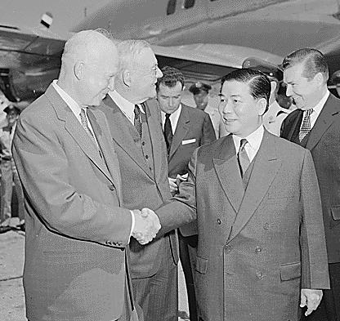
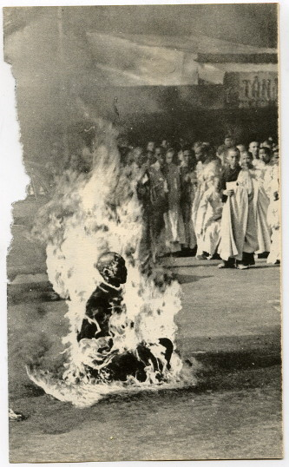
Vietnam
US backs Ngo Dinh Diem in South Vietnam
Economic aid increases steadily

Slide 9
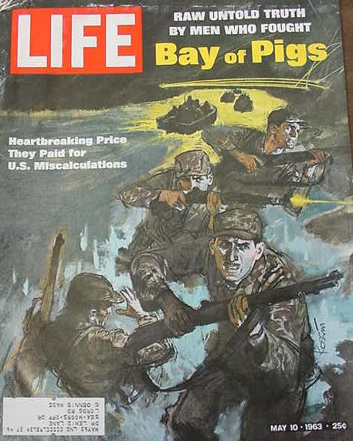

Cuba
Bay of Pigs Fiasco
April 17, 1961
Failed attempt to overthrow Castro

Slide 10
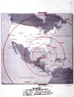
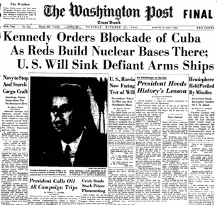
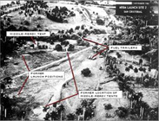
Cuban Missile Crisis
October, 1962
Soviets attempt to mount armed nuclear missiles in Cuba.
13 days of tension
Soviets back down if US agrees to pull troops from Turkey.

Slide 11
Kennedy’s Domestic Policy
New Frontier
Did not have the support of Congress
Sluggish economy
Slow attack on Civil Rights
  Thurgood Marshall appointed to Supreme Court
  CORE and Freedom Rides
  Integration of University of Mississippi
  March on Washington

Slide 12
Expansion of Individual Rights
Warren Court
  Gideon v. Wainwright: All accused must have lawyer
  Miranda v. Arizona: All accused informed of rights
  Baker v. Carr: Equal representation in government
  Engle v. Vitale: Bans prayer in school

Slide 13
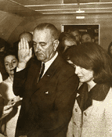
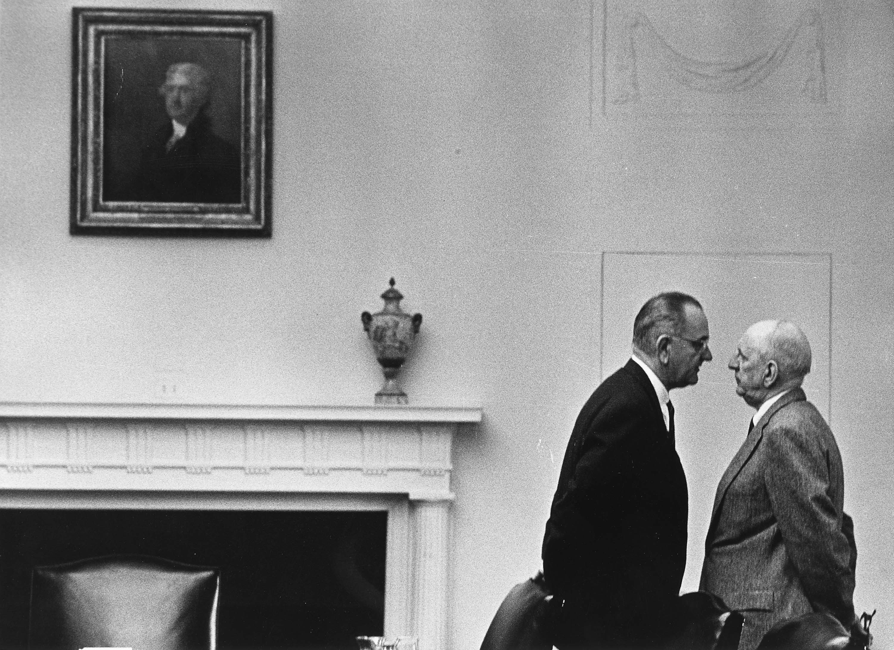
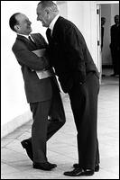
“Let Us Continue”
JFK is assassinated (November 22, 1963)
Lyndon Baines Johnson is new president
Carries on the programs of Kennedy, using his unique style.

Slide 14
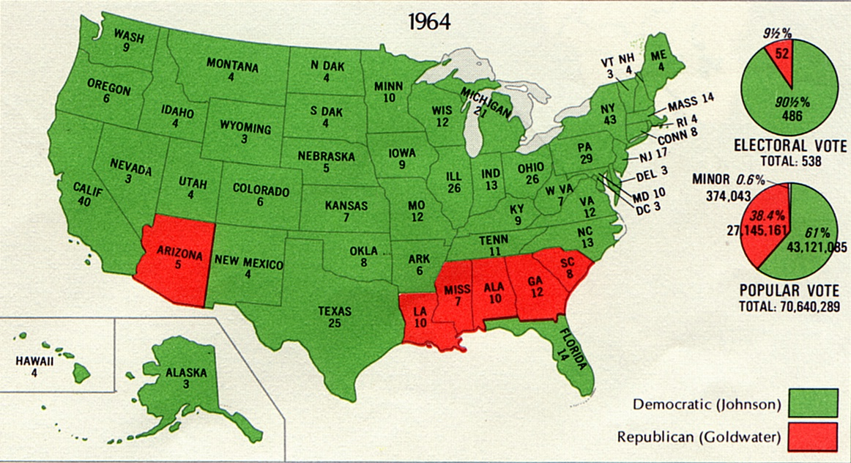
Election of 1964

Slide 15
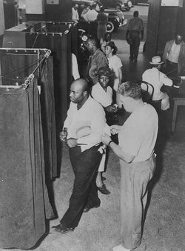
Johnson’s Reforms
Medicare and Medicaid
Head Start (Elementary and Secondary Education Act)
Civil Rights Act (Ends segregation in public facilities)
Voting Rights Act (Banned literacy tests)

Slide 16
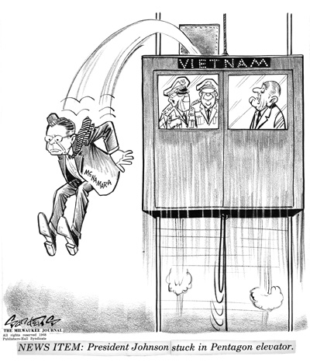
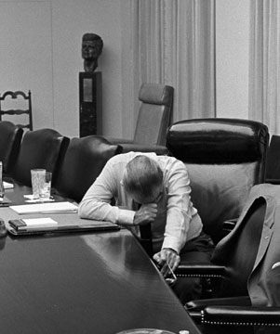
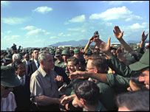
Vietnam
Drastically escalates the war
Gulf of Tonkin Resolution (President given power to increase war effort.)
Leads to stalemate
Ends Johnson’s Presidency

Slide 17
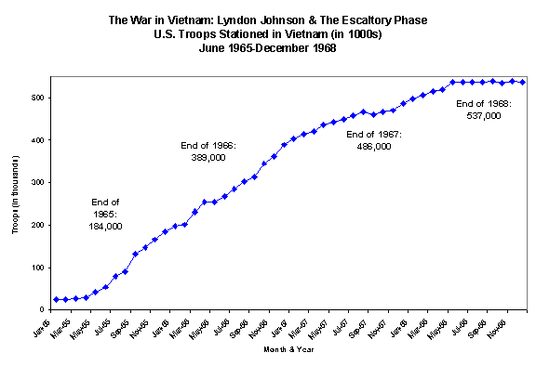
US Troops in Vietnam

Slide 18
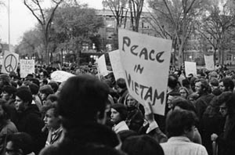
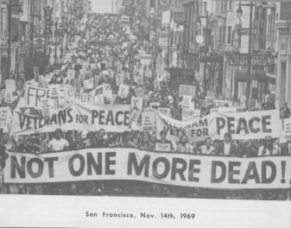
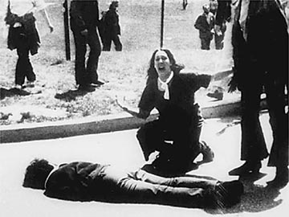
Student Revolt and Protest

Slide 19
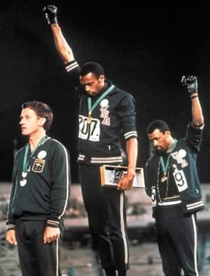
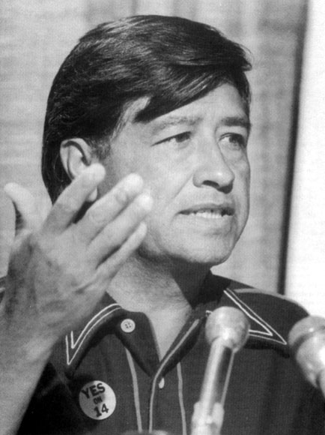

Cultural Revolution
“Black Power”
Ethnic Nationalism (Caesar Chavez)
Women’s Rights (Betty Friedan)

Slide 20
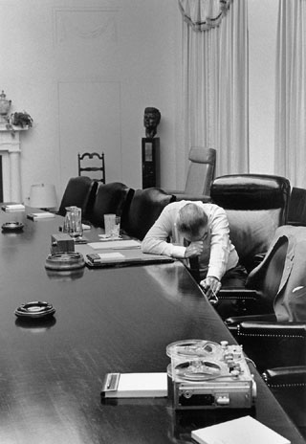
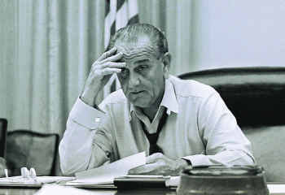
Vietnam Defeats Johnson
Decides not to run
Splits the Democratic Party
Republicans will reemerge
Richard Nixon

Slide 21
Violence at the Convention
Democratic disagreement spilled over on the convention floor
  Eugene McCarthy and Robert Kennedy – Anti War
  Kennedy assassinated during spring campaign
  Hubert Humphrey – Mainline Democrat
Held in Chicago
Mayor Richard J. Daley called for tight controls on riots outside of convention site.

Slide 22
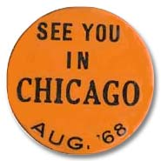
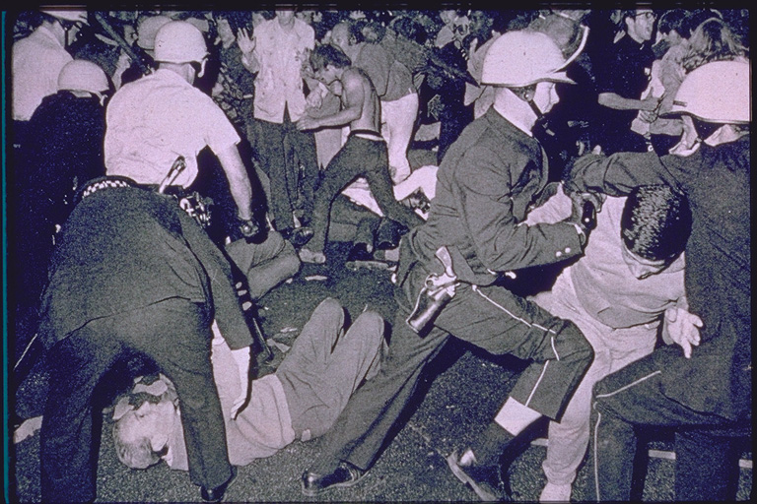
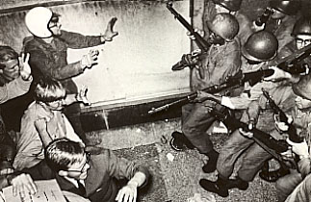
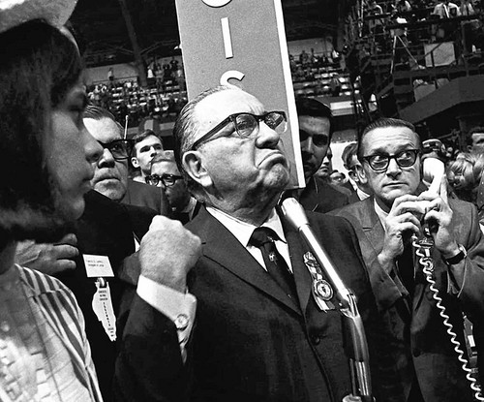
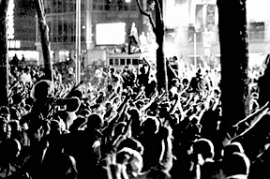
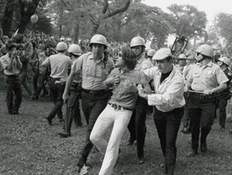

Slide 23
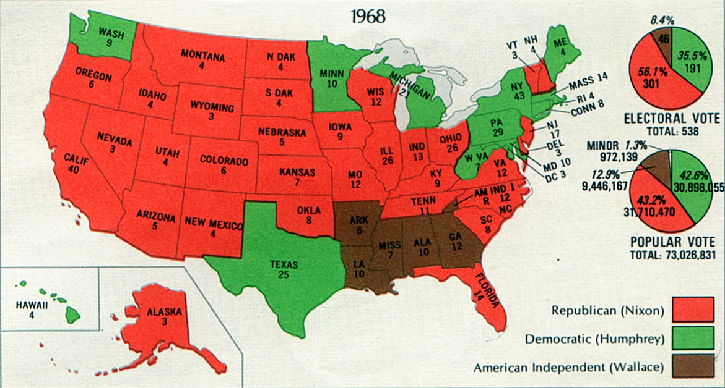
Election of 1968

Slide 24
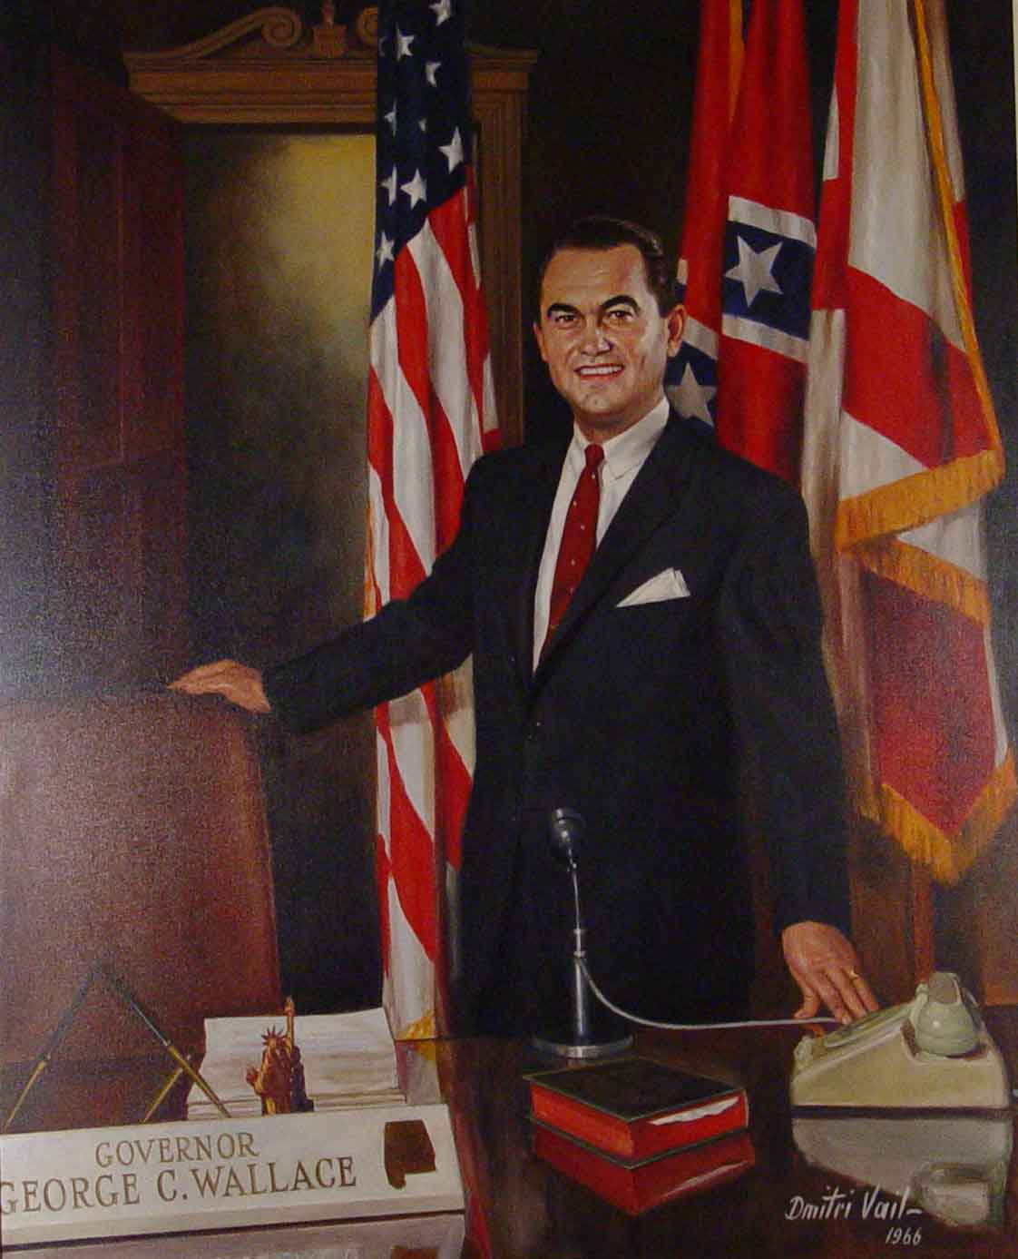
Nixon’s Stand on the War
The U.S. should “end the war and win the peace”.
Vague approach to ending the Vietnam War
Democrats hurt by 3rd party candidate – George C. Wallace – running on a segregation platform.

Slide 25
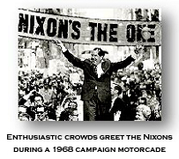
Nixon Won
Smallest share of popular vote since 1916.

Slide 26
Which of the following is true of the Kennedy-Nixon debates?
Were broadcast on TV but not on radio
Were broadcast on radio but not on TV
Those who watched on TV thought Kennedy won; radio listeners thought Nixon won
TV watchers thought Nixon won; radio lsiteners thought Kennedy won
Most people considered it a draw between the two candidates

Slide 27
Which of the following accurately describes the election of 1960?
Kennedy won by a wide margin
Kennedy won by a narrow margin
Kennedy won the Electoral College but lost the popular vote
Election was decided by the House of Representatives
Nixon defeated Kennedy in a landslide

Slide 28
What was Kennedy’s alternative to Eisenhower’s “massive retaliation” policy called?
Limited retaliation
Massive response
Flexible response
Containment
Rllback

Slide 29
What caused the Cuban Missile Crisis?
Soviets invaded Cuba
Americans invaded Cuba
Americans placed nuclear missiles in Cuba
Cuba developed a nuclear arsenal
Soviets placed nuclear missiles in Cuba.

Slide 30
Which of the following was probably LBJ’s greatest asset in getting legislation passed?
His great ability in dealing with Congress
He was beloved by the American people
His personal charm and good looks
His mastery of minute policy details
His great speaking ability

Slide 31
The 1964 Civil Rights Act
Made illegal the segregation of blacks in public facilities
Established an Equal Employment Opportunity Commission
Protected the voting rights of African Americans
Was filibustered for 57 days
All of the above are true.

Slide 32
Which of the following best describes the Democrats in the election of 1968?
Unified behind LBJ
Unable to find any candidates
Fractured and divided
Certain Nixon would win
Enthusiastic about George McGovern

